Slide 1
Comparative Anatomy of Female Reproductive System in Domestic Animals

Slide 2
Ovary
Location 1. mare :
The ovaries in mares is suspended by broad ligament dorsally to ventral cavity toward the lumber vertebra and displaced during weight gain and increase of uterine consistency .

Slide 3
2. Cow :
its located craniolateral of the broad ligament and cranially to the pelvic inlet and parallel to the internal cervical opening
the ovary is suspended by mesovarian ligament and ovariouterine ligament , in the meeting of this two ligaments , they form ovarian fossa . During pregnancy the ovaries is displaced to the ventral cavity.

Slide 4
3. Dog & Cat :
its located in the abdominal cavity , caudal to kidney because the length of the uterine horn , it is attached to the dorsal body wall by mesovarian , to the diaphragm by suspensory ligament and to the end of the uterine horn by proper ligament of the ovary.

Slide 5
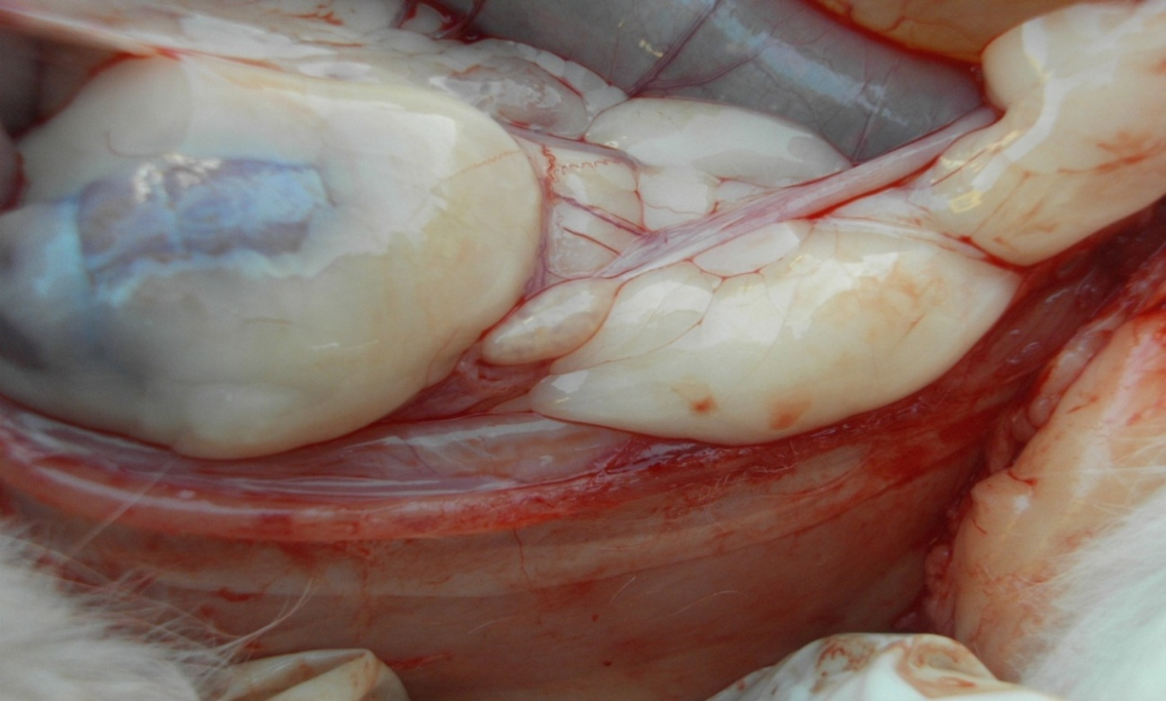
Ovary caudal to kidney in queen

Slide 6
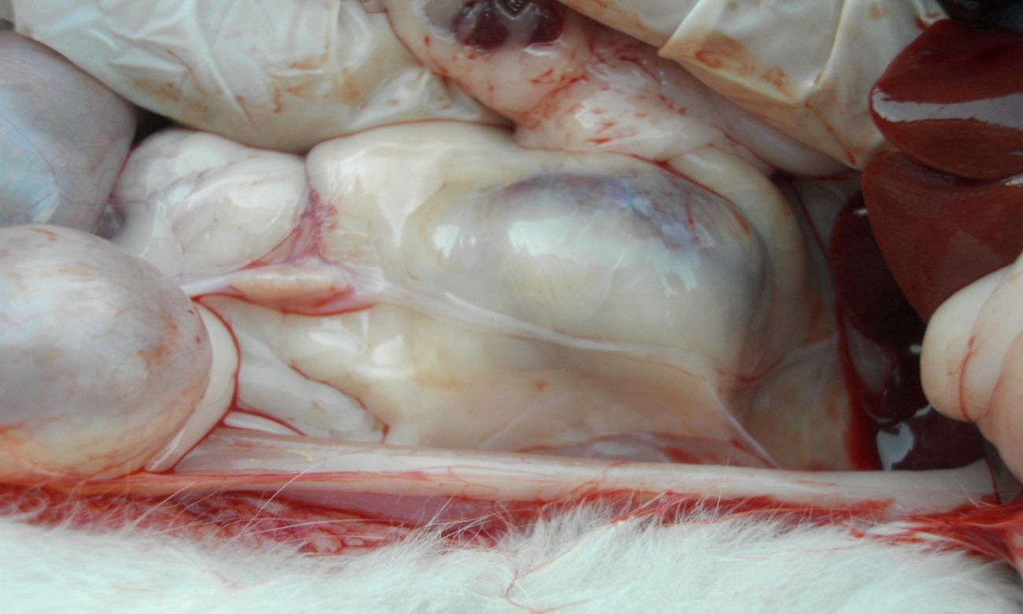
Suspensory ligament of ovary

Slide 7
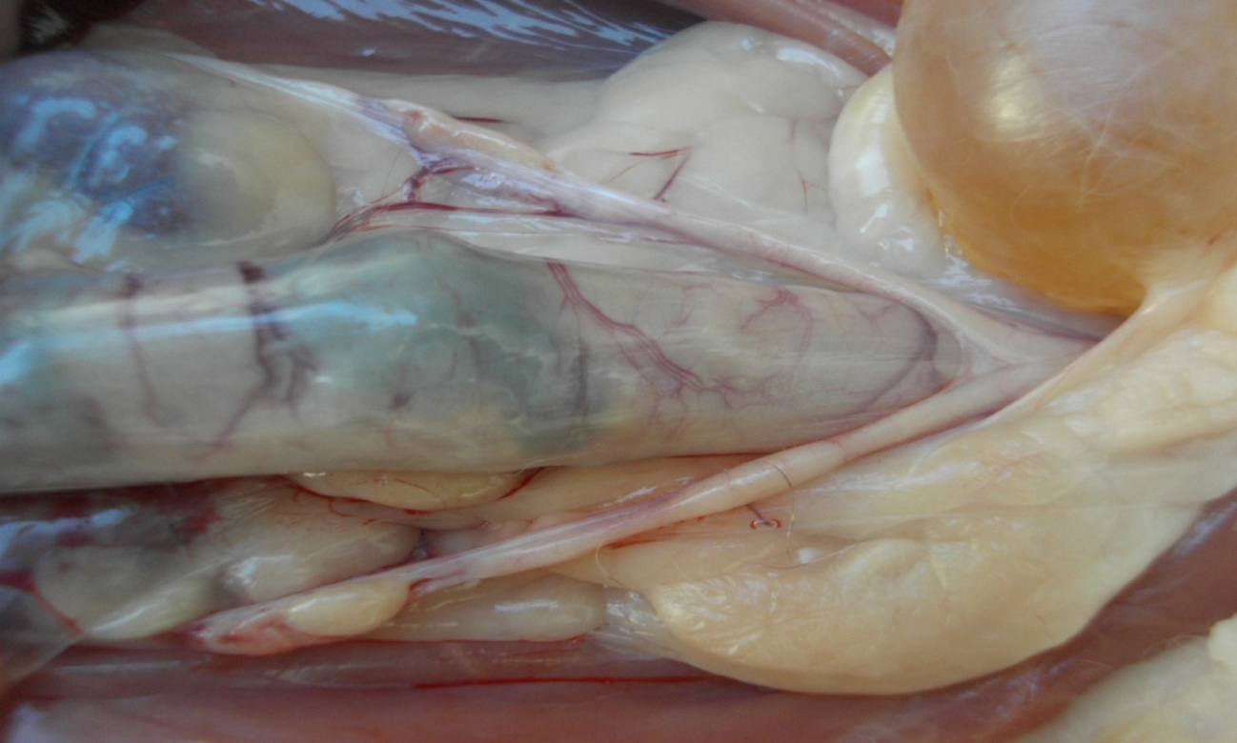
Reproductive system in queen
Bladder
Colon
ovary
Proper L.

Slide 8
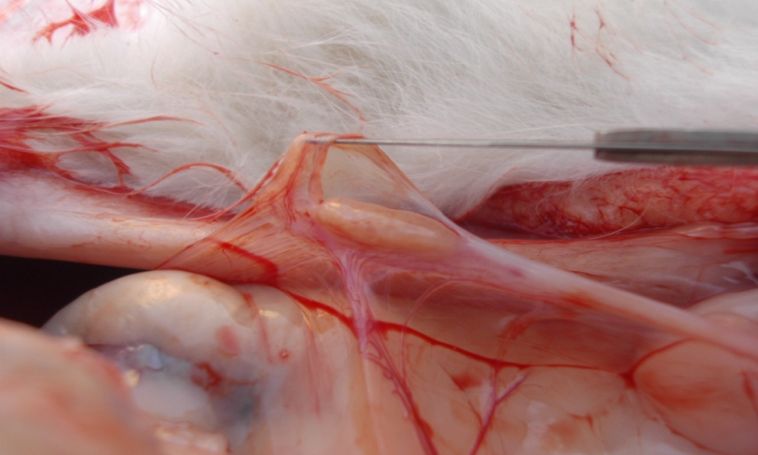
Ovarian bursa in queen

Slide 9
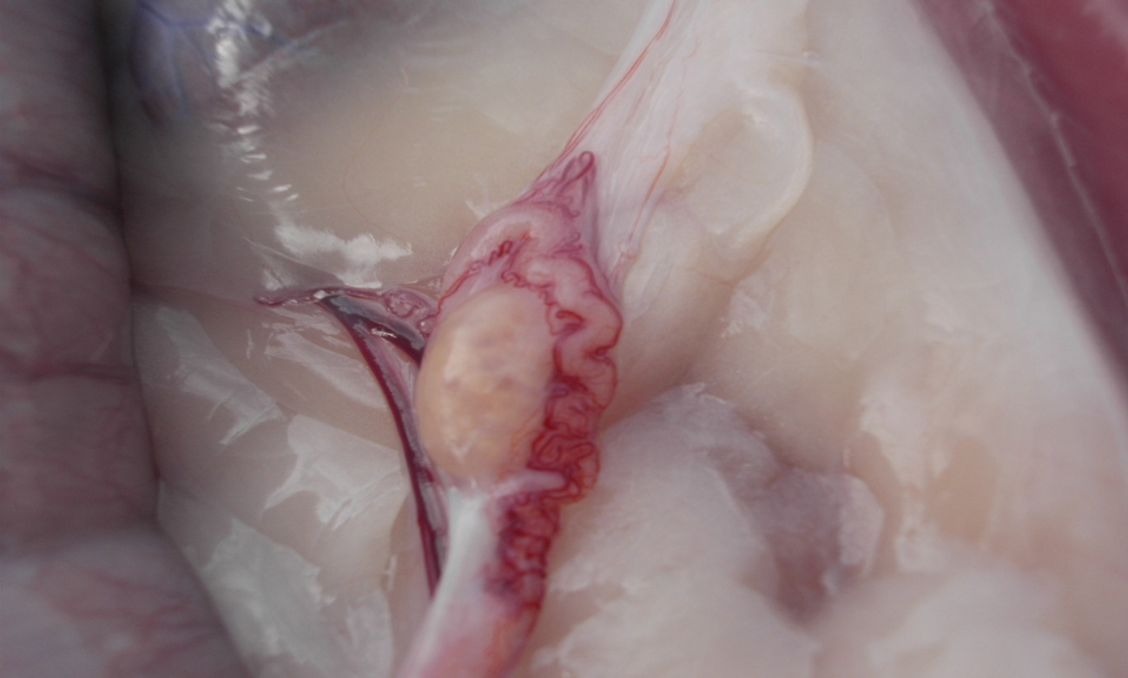
Uterine tube in queen

Slide 10
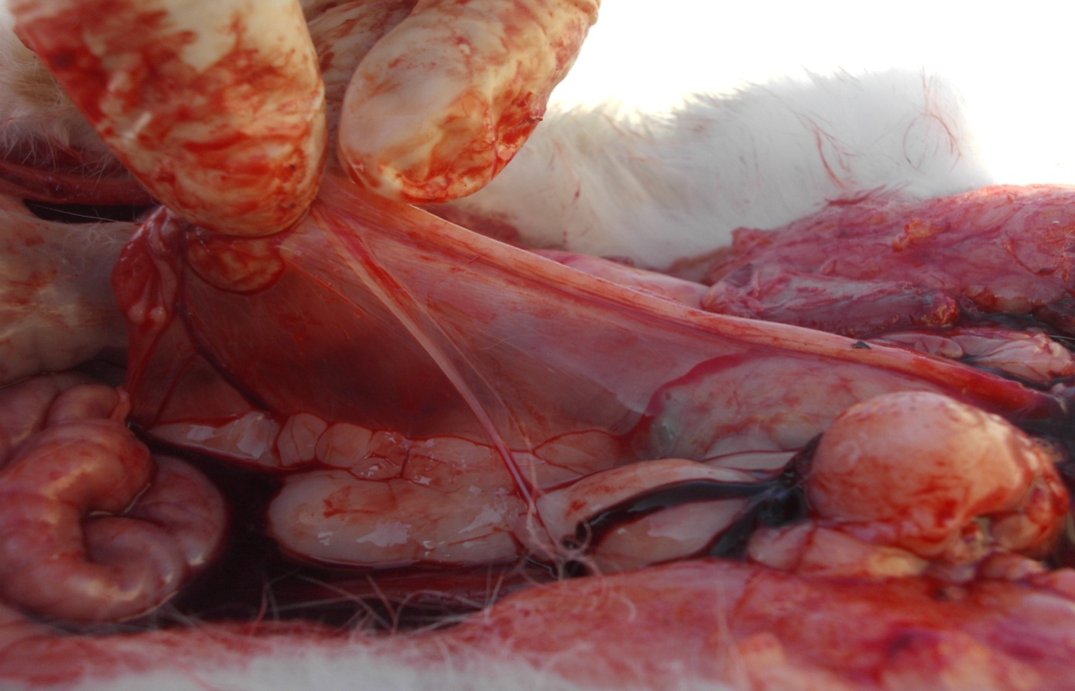
Broad and round ligament in queen

Slide 11
Ovary in Cow
Oval shape
Smaller than mare in size
Ovulation occur in any part of its surfaces
C.L. can be identify
No blood vessels appear on its surface
dimensions
1.5 – 5 cm long
1 – 2 cm width
0.5 -1.9 cm thickness

Slide 12
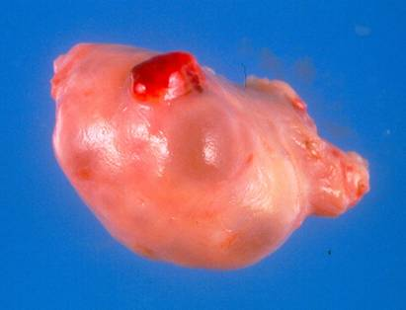
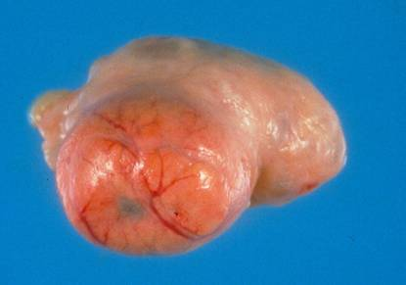
Ovary of cow
Mature Corpus
Luteum
Follicles and
New Corpus
Luteum

Slide 13
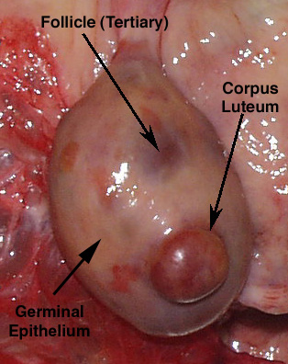
Ovary of cow

Slide 14
Ovary of Mare
Kidney shape
in size larger than cow
ovulation occur in ovulation fossa only
C.L. can not be identify on its surface
has blood vessels on its surface
Dimensions
6 cm long
4 cm width
3 cm thickness

Slide 15
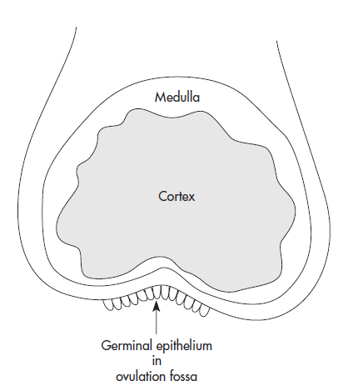

Slide 16
Blood Supply
1. Ovarian artery
a. ovaries and oviducts
b. cranial part of the uterus
2. Uterine artery
a. major part of the uterus
3.. Vaginal artery
a. vagina

Slide 17
Histologically:
The ovary composed from a network of broad ligaments and blood vessels surrounding the ovary except the "Hillus" which the blood supply and nerves are enter. The ovary composed from 2 layers:

Slide 18
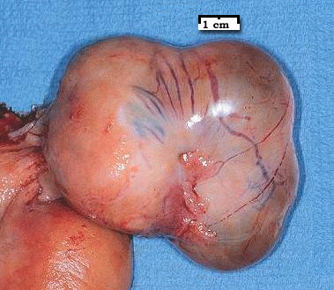
Ovary of mare wit follicle
Notes:
Ovulation normally occurs when follicle reaches 4-5 cm

Slide 19
The uterine tube:
Synonyms:
Oviducts.
Fallopian tube.
Salpinges.
The uterine tube are a long convoluted tube start with ovary and end in to the uterine horns (15-30 cm in long) and consist from three parts:
Infundibulum.
Ampulla.
Isthmus.

Slide 20
Functions:
Transport and capacitation of both ova and sperms.
Site of fertilization (ampulla-isthmus junction).
Filtration of dead sperms (isthmus)

Slide 21
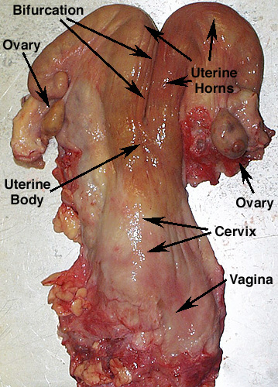
Uterus
the animals is divided into
groups according
to the uterus
Bipartite uterus
( cow , ewe and mare )

Slide 22
Primates have simplex uterus with one cervix and very prominent body ,horns are absent
swine have bicornuate uterus ,with the horns folded or convoluted
Rodents have duplex uterus , with two cervices ,no uterine body ,and with the horns completely separated

Slide 23
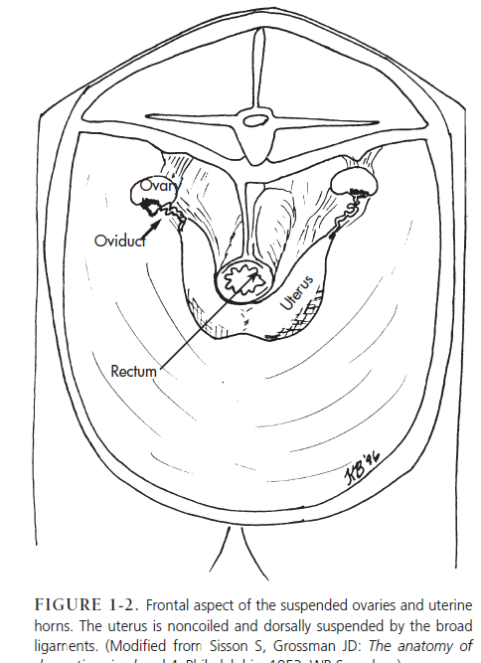

Slide 24
Bicornuate uterus (cat , dog and pigs )

Slide 25
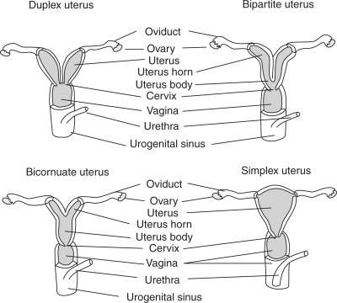
simple uterus (human and primate )

Slide 26
Cervix:
A cylindrical, cartilaginous stricture act as a sphincter between uterus and vagina (5-7 cm in long and 3-5 cm in diameter). The structure have a 3-5 rings called "annular rings" and have 2 orifice (internal and external).

Slide 27
Functions:
Protection of the uterus from any foreign.
Good site for deposition of the semen in artificial insemination (cow, ewe) or in normal copulation (mare, sow).
Good storage for spermatozoa.
Filter for dead spermatozoa.
Secretion a mucous during estrus and pregnancy.
Strong sphincter to close the uterus and prevention of the fetus during pregnancy period.

Slide 29
Vagina:
Copulation organ in the female (matched to the penis of male) composed from muscular layer and serosal layer. The vagina have:
Vestibule:
It is a mutual part between urinary and genital tract (2-12 cm in long). The urethra open at the base of vestibule by urine orifice.
The vestibule separated from the vagina by an edge called "hymen".
Gartner's cannels:
Vestigial cannels open bellow the vestibule.

Slide 30
Bartholin glands:
Two glands located on either side of vestibule, secreted a mucous secretion during the copulation aid to make a lubricant for male penis.
Vulva:
External opening is a common opening between the urinary and reproductive tract, it consists of: Labia: Composed from outer skin, hairless, and it’s an elastic structure that form a closure to minimize the entrance of foreign material into the reproductive tract. There are 2 "labia minora" which found in (women, advanced mammals) and absent in most farm animals, and "labia majora" which found in all females.

Slide 31
Clitoris:
Genitalia erectile has same generated penis in the male, composed from erectile tissue and equipped with nerve endings and is very sensitive especially in the estrus stage. The clitoris is very developed in a mare and erect during intercourse
Hymen:
A thin membrane separates the vestibule from the vagina, and it is located in some of the females (women) and missing or vestigial in others (cattle). Hymen have a holes allow the passage of uterine secretions and blood during the reproductive cycle.

